Slide 1

“Everyone deserves to feel safe in their city”
Notes:
click to get to LOGO

Slide 2
Team Members
<FULL STACK/>
Karen Henderson
Jenn Lara
<BACK END/>
Francis Arcede
Dennis Feliciano
Zarna Patel
<FRONT END/>
Claire Allen
Jurabek Kenjaev

Slide 3
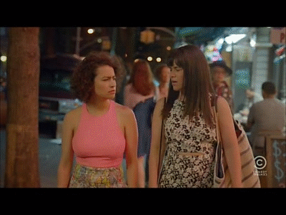
Inspiration

Slide 4
Concept
To allow users to report any form of street harassment that they experience or witness by location.
To allow users to report street harassment incidents by location and datetime.
To allow users to view the map of harassment incidents and description.

Slide 5









Technologies

Slide 6
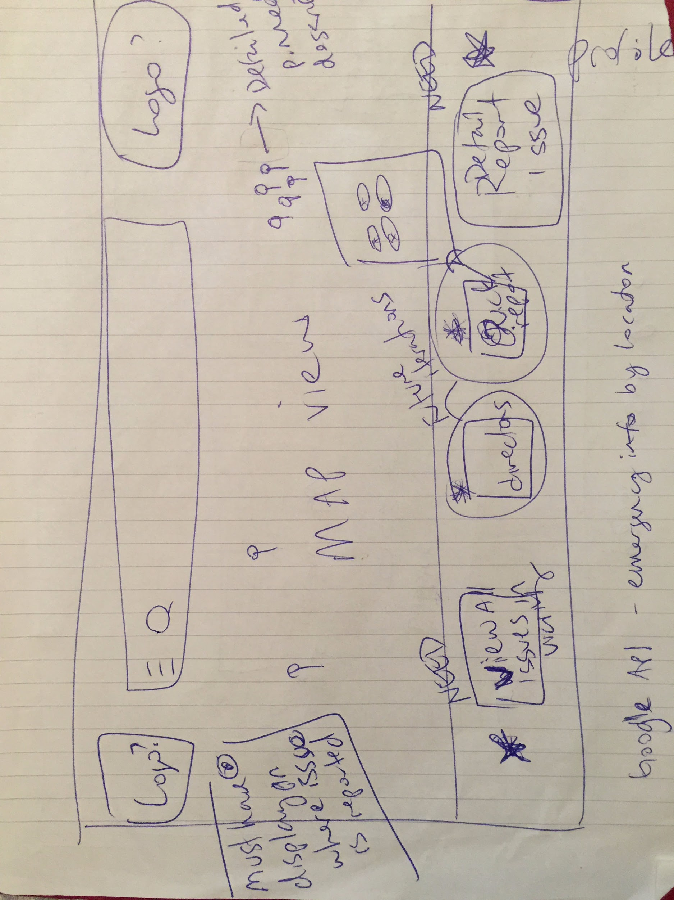
WireFraming

Slide 7
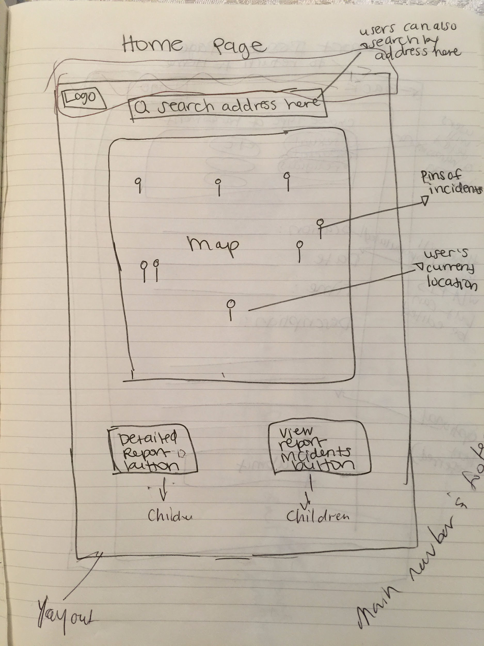
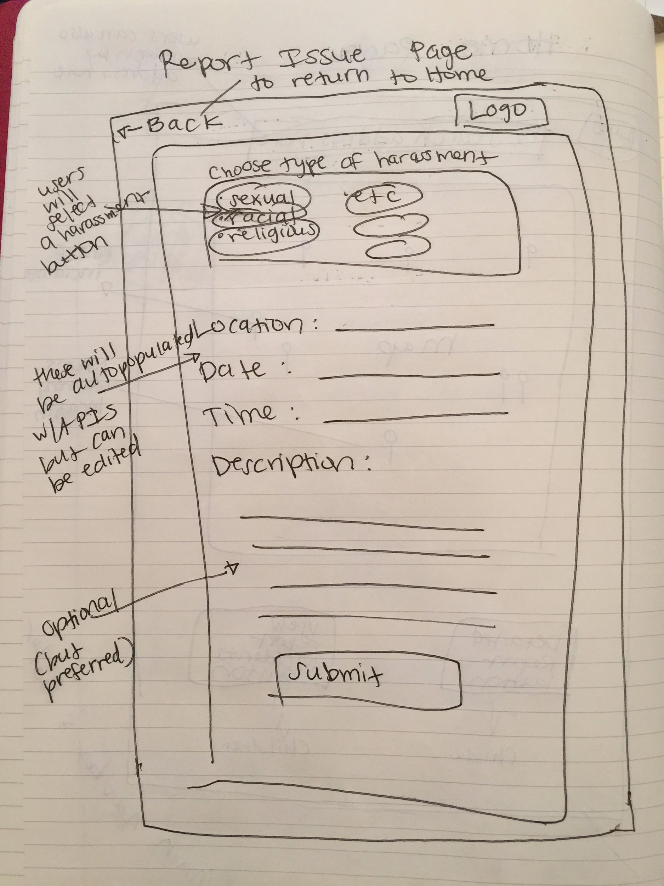
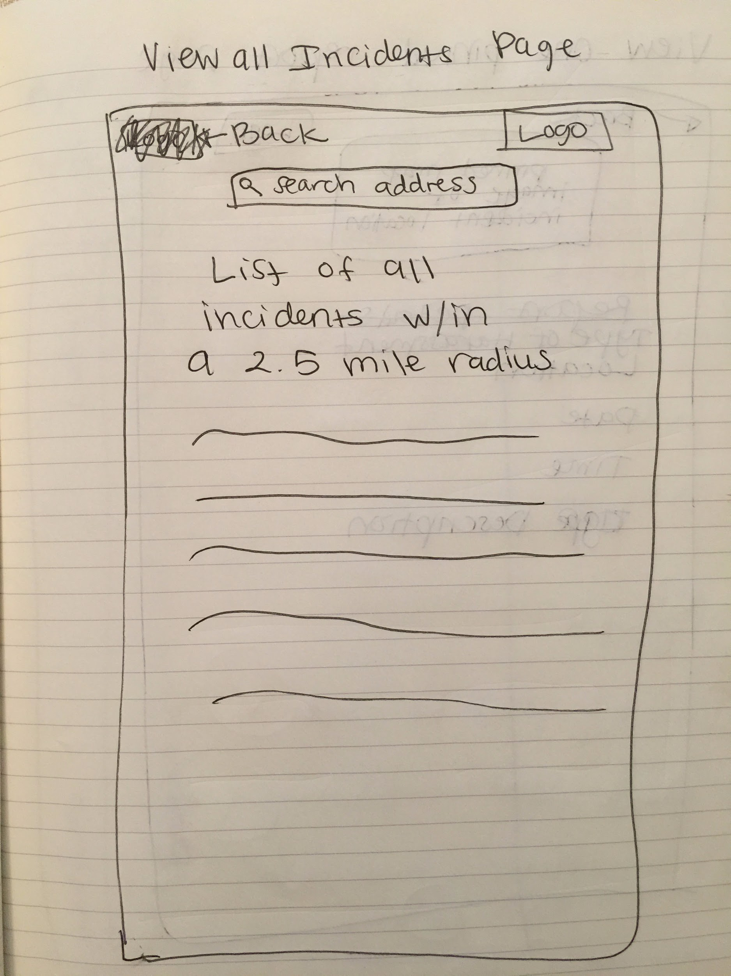
WireFraming

Slide 8
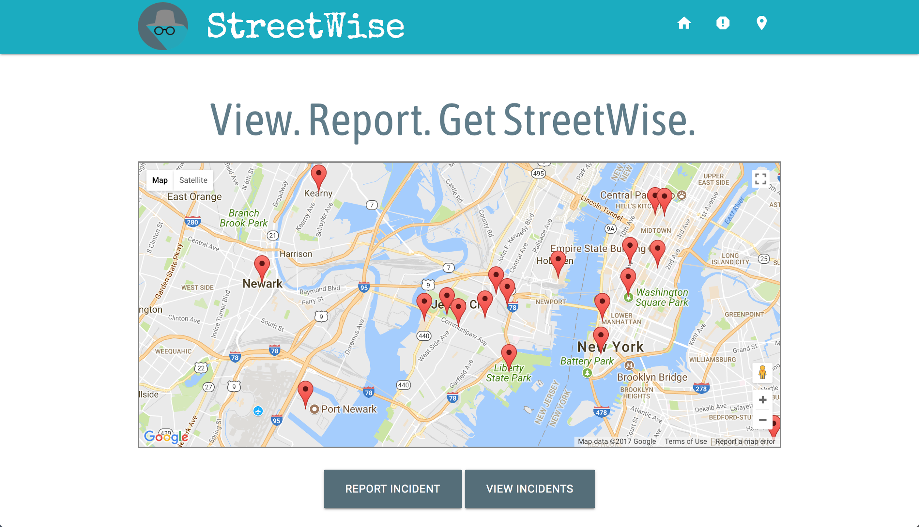
Demo
https://streetwiseapp.herokuapp.com/

Slide 9
Challenges:
Front End
Deciding on which Front End framework to use. Pros and Cons of Bootstrap.
Designing so that responsive features remain intact.
Incorporating logo in a creative manner.
Communication
Back End
Proof of Concept: communication between front and back end
Validation of Schema
Geolocator
Post Route
Specifying collection on mLab for get route
React

Slide 10

Questions?

Slide 11

everybody:
PULL!!!!!!

